Slide 2
01
Creation of Quality Attribute(QA) Template

Slide 3
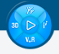

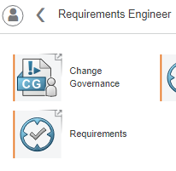
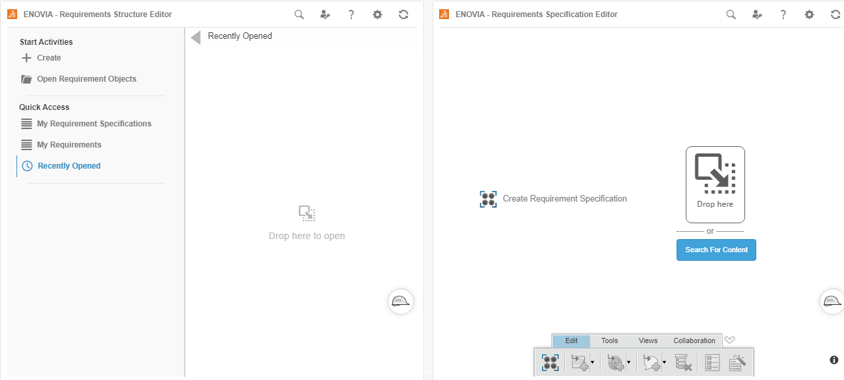

Creation of QA Template
1
2
Open the Requirement Structure Editor
To create a QA Template, we will use the Requirement Structure Editor app.
Click on 3D Compass.
Then, Click on 'Requirement Engineer' under 'My Roles'.
Click on 'Requirements' app.
Requirements app is opened. Requirement Structure Editor on the left and Requirements Specification Editor on the right.
3
4

Slide 4
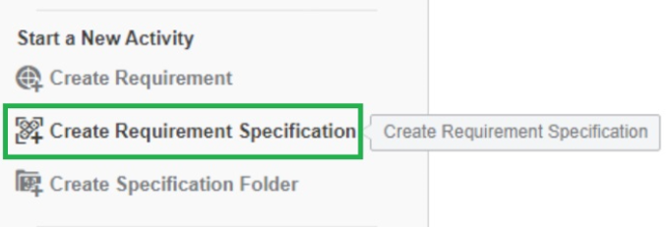
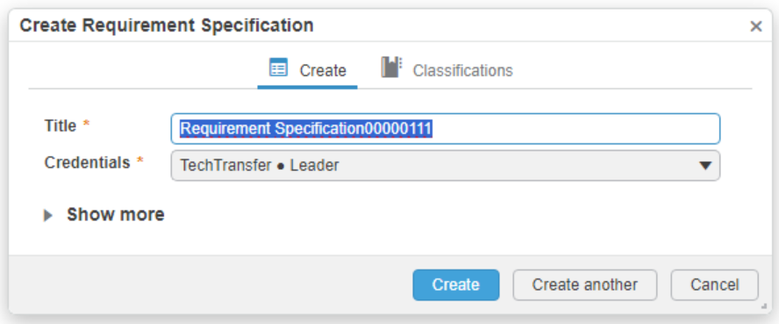
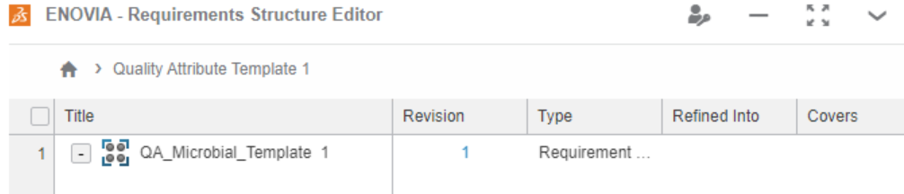
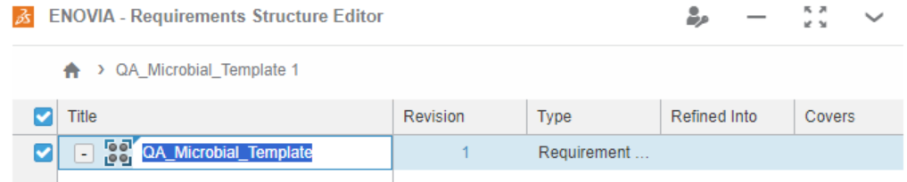
Creation of a Requirement Specification
1
To create a "Requirement Specification" (QA Template Header) object and to attach "Chapter".
2
Under Requirements Structure Editor app, Click on 'Create Requirement Specification' under 'Start a New Activity'.
The object will appear with a default name. (which could be edited , For this use case it is named as "QA_Microbial_Template")
Requirement Specification named as "QA_Microbial_Template" is created and displayed under Requirements Structure Editor.
To edit the name after it has been created, Double click on the object to rename it
3
4

Slide 5
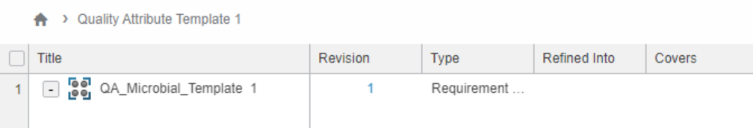
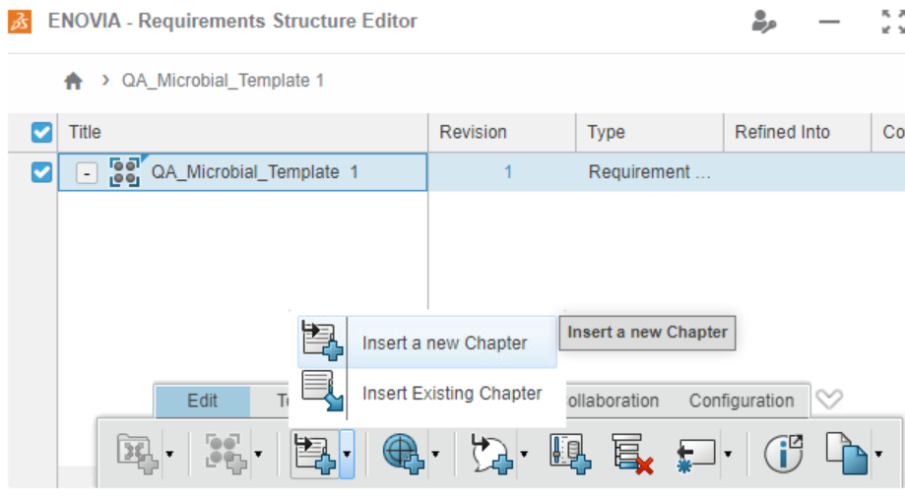
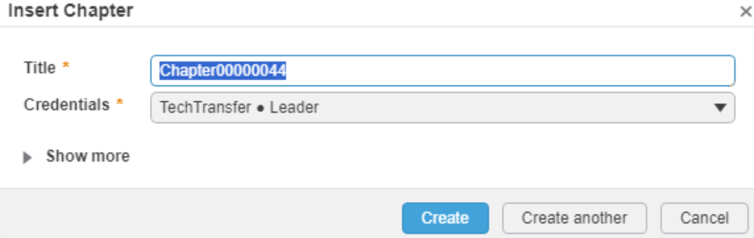
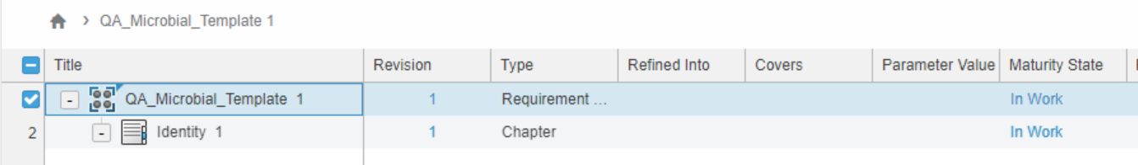
Creation of a chapter
under Requirement specification
1
Create a Quality Attribute Category for Product Components
Under Requirements Structure Editor app, Select the "QA_Microbial_Template" created previously.
Click on 'Insert new chapter' icon and click on 'Insert a new chapter'.
New Chapter will be created with a default name which has been renamed as "Identity" and click on "Create". The newly created chapter will appear under QA_Microbial_Template.
User can create multiple QA category in the Template by following step 2 and 3.
2
3
3

Slide 6
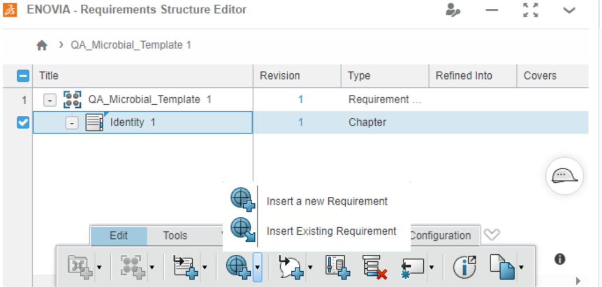
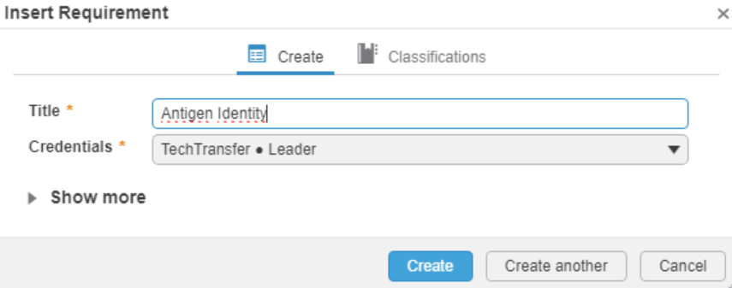
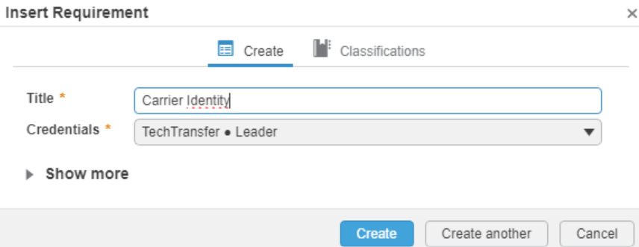
Creation of a Requirement under Chapter
1
To create a “Quality Attribute" for a Quality Attribute category.
2
Under Requirements Structure Editor app, Click on previously created Chapter object 'Identity' and click on 'insert a new requirement’.
The object will appear with a default name. Click on ‘Create’ button. (which could be edited , For this use case the newly created requirement are named as "Antigen Identity“)
Follow the Step 1 and 2 to create another Requirement (Example: "Carrier Identity").
2

Slide 7
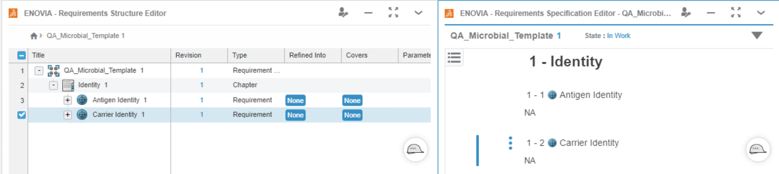
Creation of a Requirement under a Chapter
The newly generated Structure under the 'Requirement specification editor' it is illustrated in the above Fig.
NOTE: When creating the template, on the "Requirement Specification Editor" under the Requirements(‘Antigen Identity’ and ‘Carrier Identity’ in the above image), created under 'Identity’, must be filled with 'NA'. (It could be done by double clicking on the free space)

Slide 8
02
Adding Extensions & Attachments to a “Quality Attribute”

Slide 9
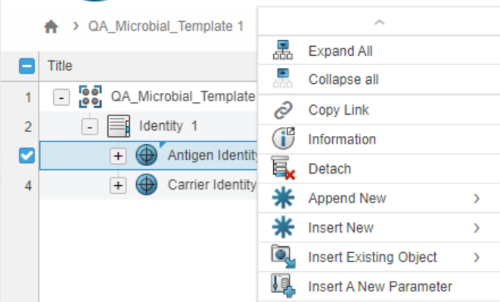
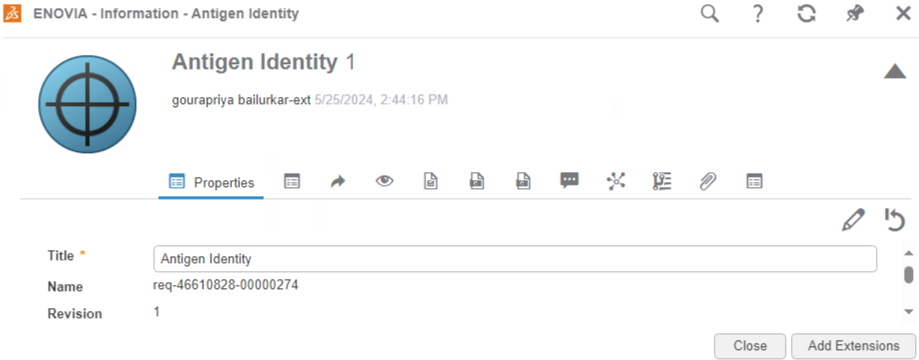
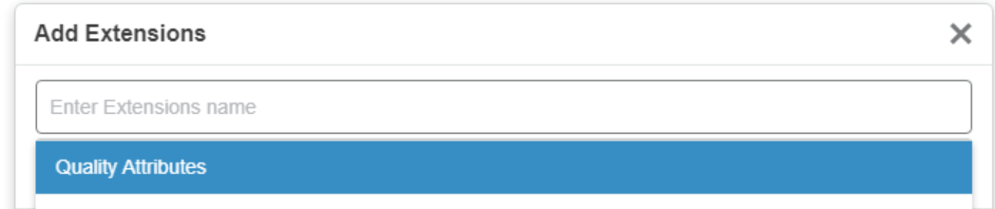
Adding Extensions and selecting attribute values from the pick list
Right click on the requirement object “Antigen Identity” and selecting Infromation from the list the properties page can be accessed.
And by clicking the Edit icon on the properties page and click on Add extensions
By selecting the Quality Attributes (from the pick list) the corresponding extension for the attributes could be added.
1
3
2

Slide 10
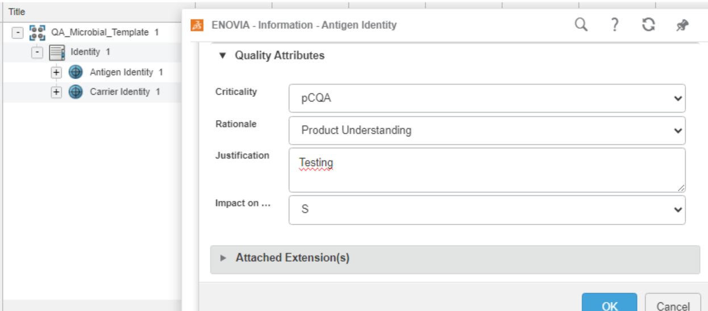
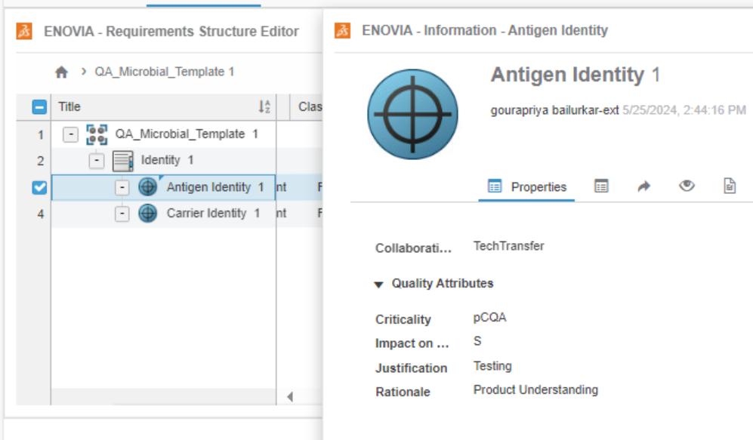
Adding Extensions and selecting attribute values from the pick list
4
4. By selecting the attribute values from the drop down list the Antigen Identity can be filled and completed by clicking on ok.
5.Once the attributes are filled it will be reflected on the properties page.
5

Slide 11
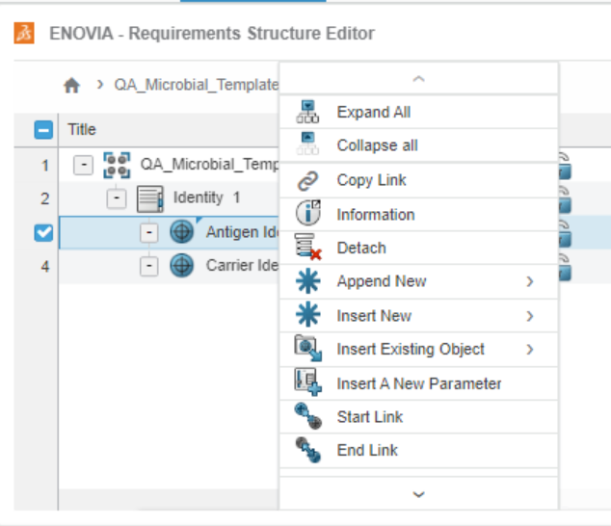
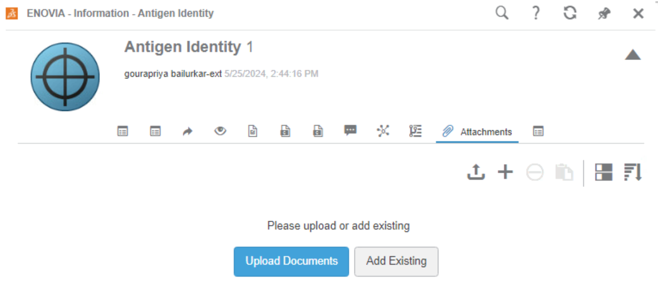
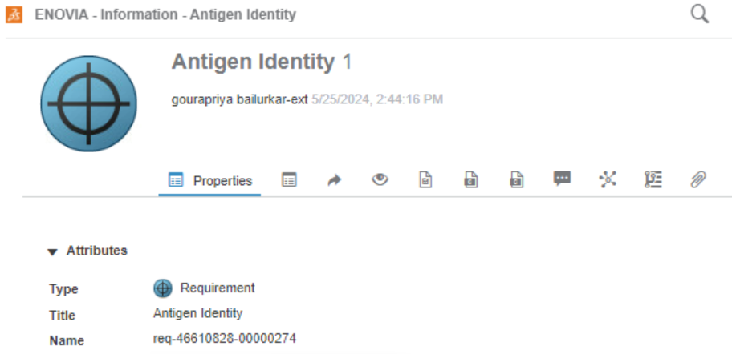
Attachment of a document under the 'Requirement'
(Antigen Identity)
1
1. By doing a right click and selecting the information on the Antigen Identity and via attachment icon, the documents can be attached.
2. On the properties page of the Antigen Identity there is an attachment icon to perform attachment
3.By clicking on the attachment icon , It opens a window with access to upload the documents
2
3

Slide 12
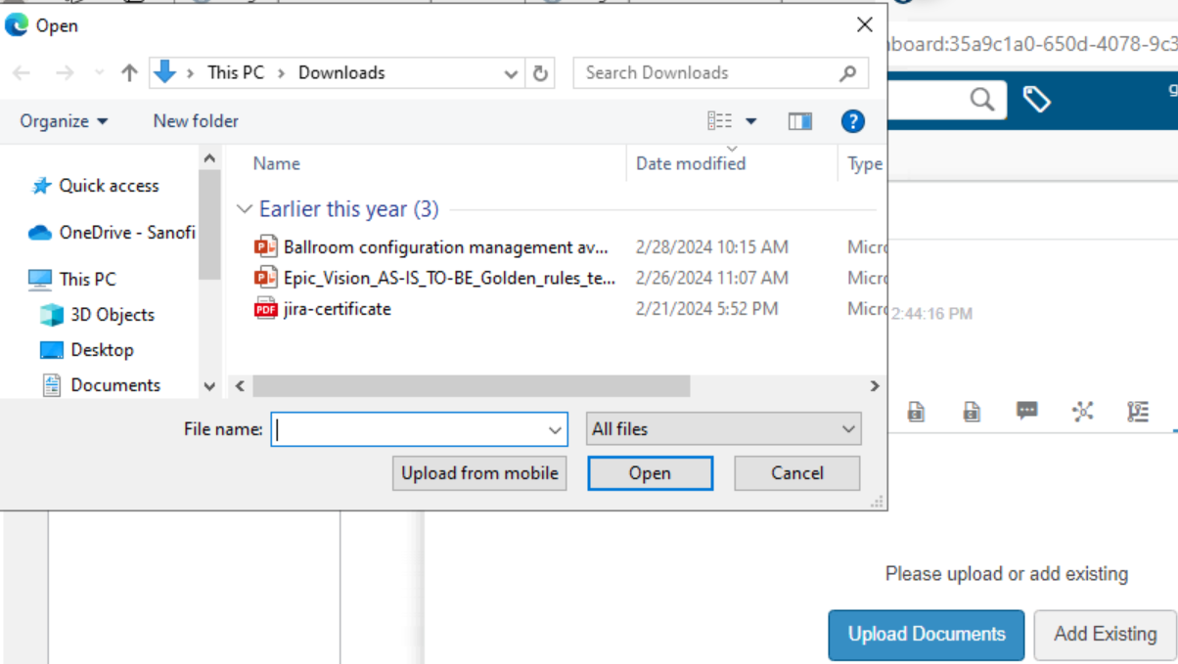
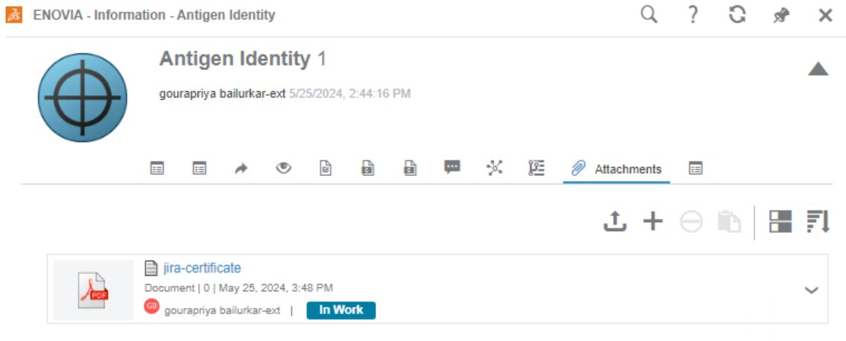
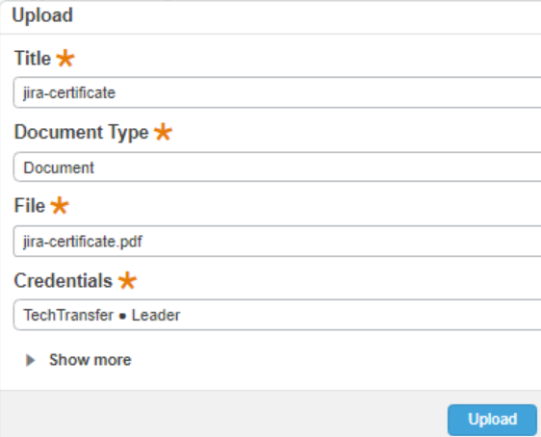
Attachment of a document under the 'Requirement'
(Antigen Identity)
4. The document that must be attached can be selected from the user's document (or any specific space from the user's machine).
5.Once the document is selected, by clicking on 'upload' will attaches the document under the properties page.
6. The uploaded document will appear directly under the attachments Icon.
4
6
5

Slide 13
03
Attaching QA Templates to a product family under Library

Slide 14
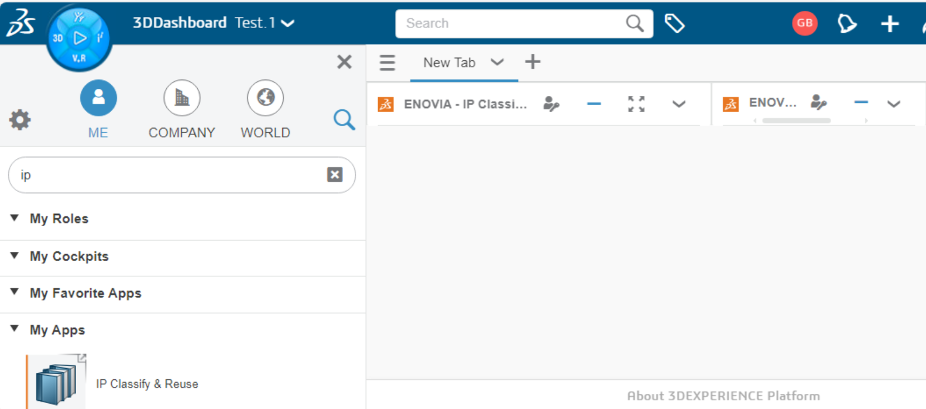
Accessing Library and attaching the newly created template
1
3
2
1. Click on 3D compass.
2. Search for IP classify & Reuse
3.Drag and Drop the 'IP classify & Reuse' widget to the 'Dashboard'
4. The widget will be appearing under the 'Dashboard' as shown in the above fig (3)

Slide 15
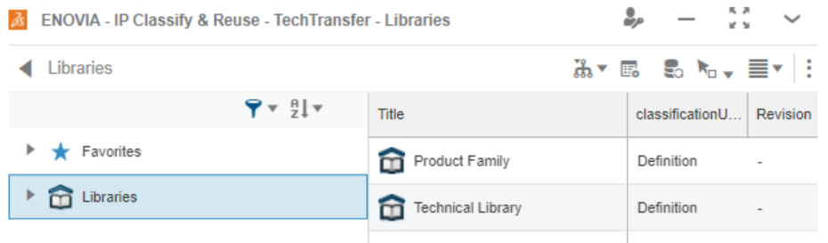
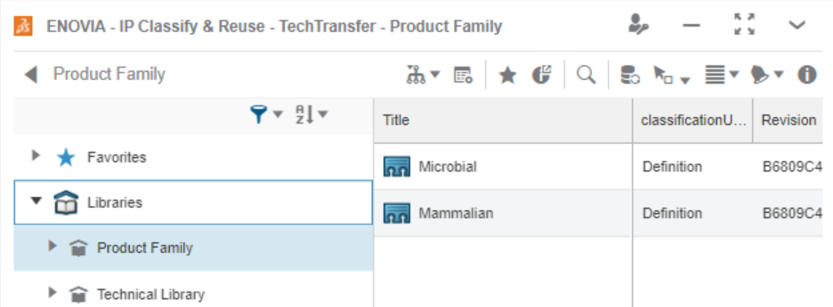
Accessing Library and attaching the newly created template
1. Click on Libraries.
2. And Click on 'Product Family', Which opens the contents associated with the product Family
3. Then click on the Microbial
2
1
3

Slide 16
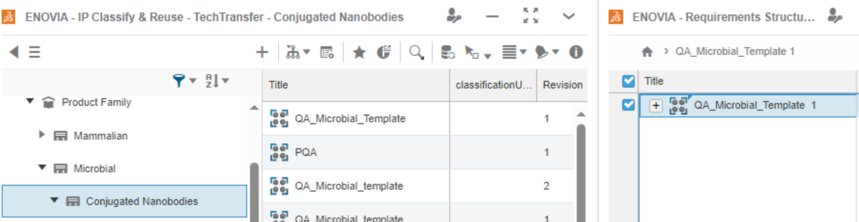
Accessing Library and attaching the newly created template
4
5
Drag & Drop
4. The Created 'QA_Attribute_TEmplate. Is drag and dropped from the 'Requirement structure Editor' widget to the
Conjugated Nanobodies (Which is a subfamily of Microbial).
5.And the added template will reflect under the structure as in the above Fig (5).

Slide 17
04
'Release' of Quality Attribute Template

Slide 18
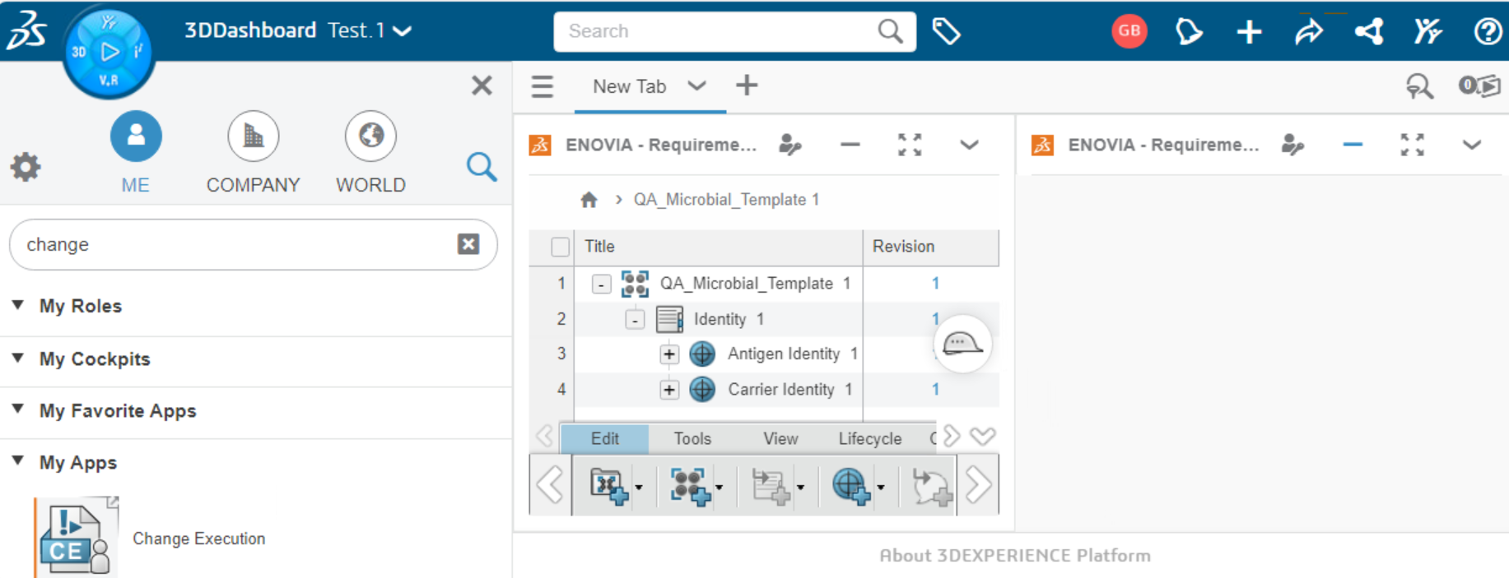
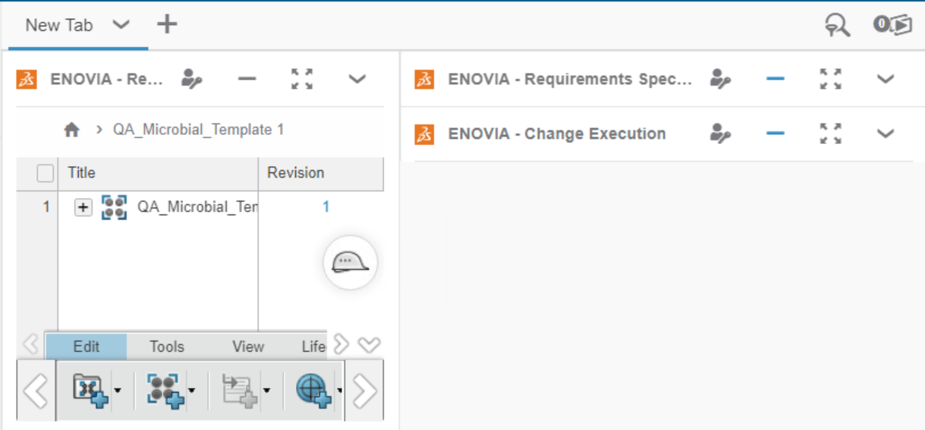
Access of 'Change Execution' Widget for the 'Release' of attribute
1
2
To 'Release' the created template it could be done via 'Change Execution Widget', To launch the widget the following steps are followed.
Through the 3DCompass the Widget 'Change Execution' could be searched.
2. And The 'Change Execution' could be drag and dropped to the 'dashboard' (In this example scenario it will be 'New Tab').
3. Once the widget is synchronized it will appear in the dashboard automatically as shown in the Fig4.
Drag & Drop
3
4

Slide 19
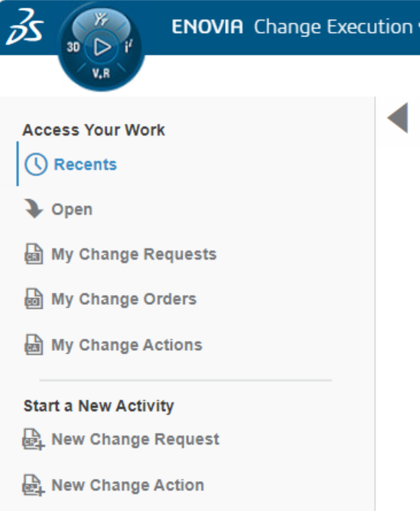
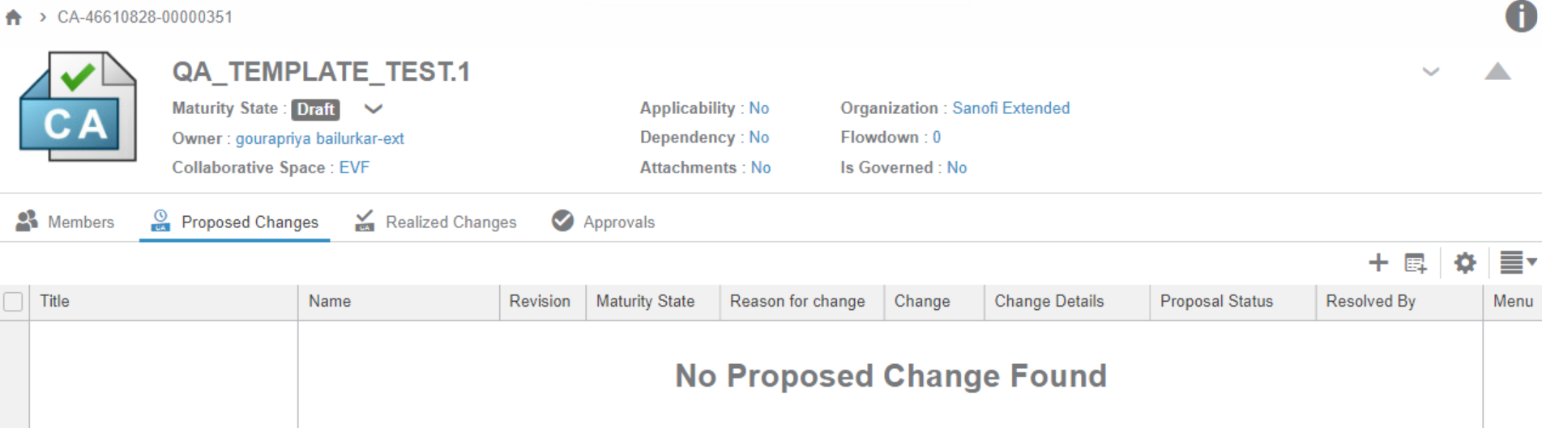
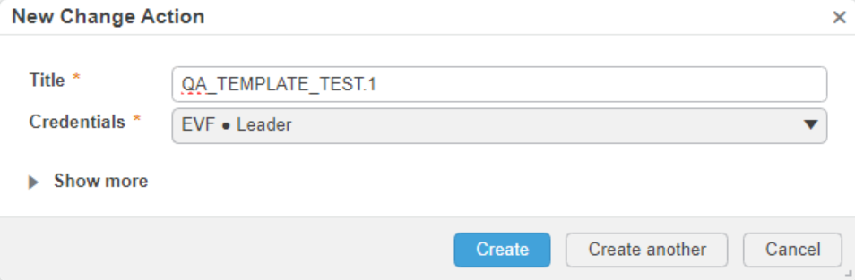
Access of 'Change Execution' Widget for the 'Release' of attribute
5
5. From Change the execution widget, create a 'New Change Action' .
6.create a New change action with title name 'QA_TEMPLATE_TEST.1'.
7. By clicking on create a New Change action has been created as shown in the fig(8).
6
8
7

Slide 20
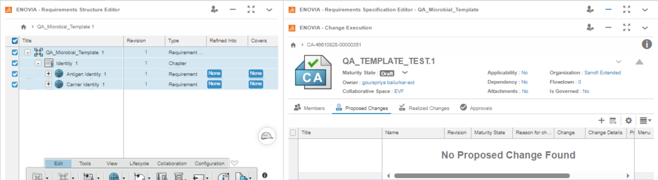
Access of 'Change Execution' Widget for the 'Release' of attribute
9
Drag & Drop
9.Select all the elements and place it under the 'proposed changes' of the 'Change Execution of the Widget via 'drag & drop'.

Slide 21
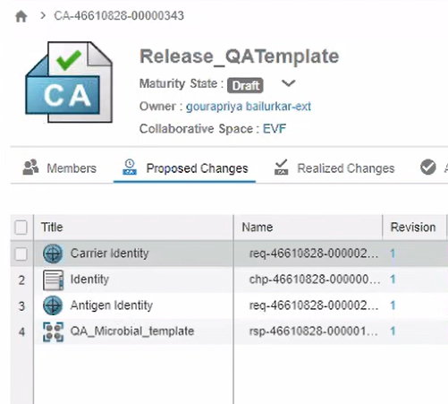
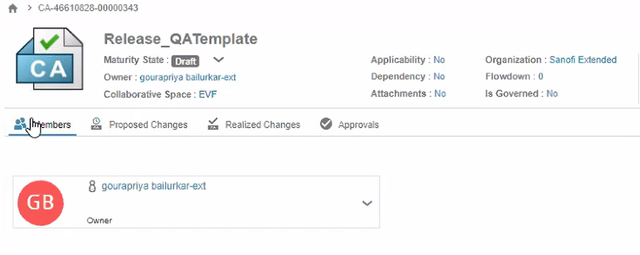
Access of 'Change Execution' Widget for the 'Release' of attribute
10.The attached attribute element 'QA_TEMPLATE_TEST.1' will be reflecting under 'Change Action',.
11.The owner of the Change Action will be seen in the below list
11
12

Slide 22
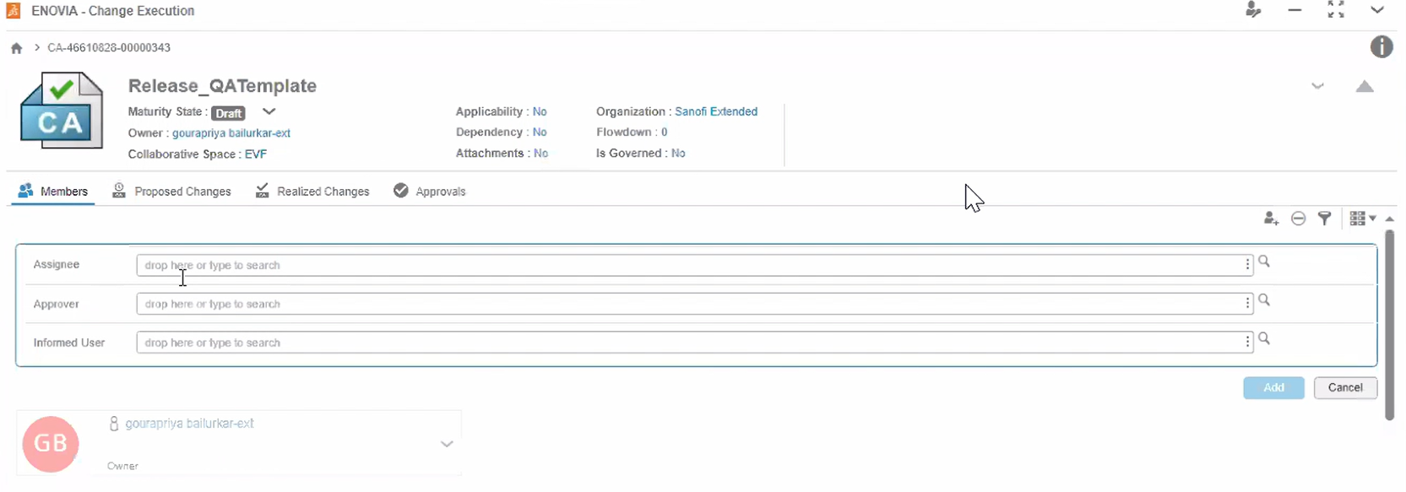
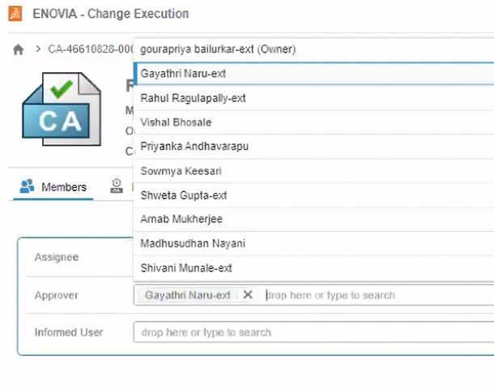
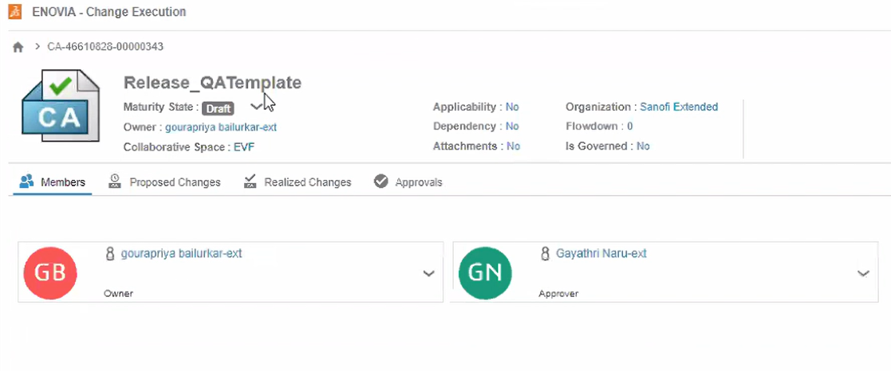
Adding of Approver to 'Release' the template
13. Under the option 'Approval' the approver to release the template could be added.
14. From the picklist the assigned approver could be selected and added.
15. The Approver will be seen in the list along with the owner of the 'Change Action'.
13
14
15

Slide 23
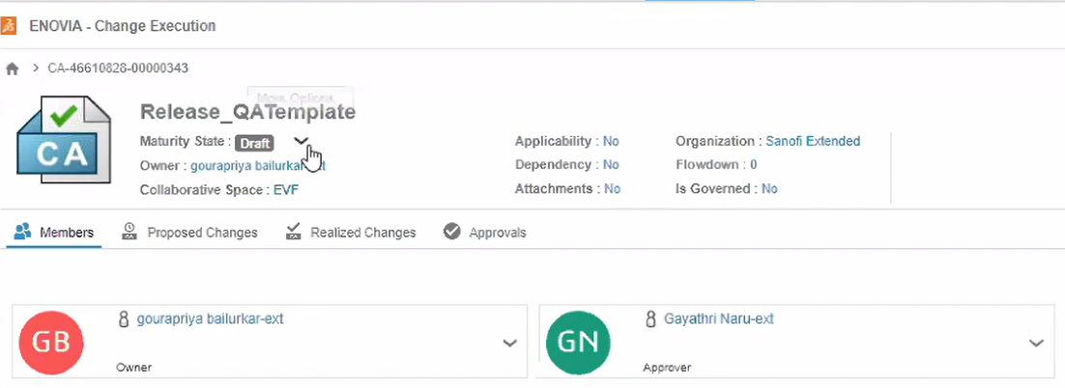
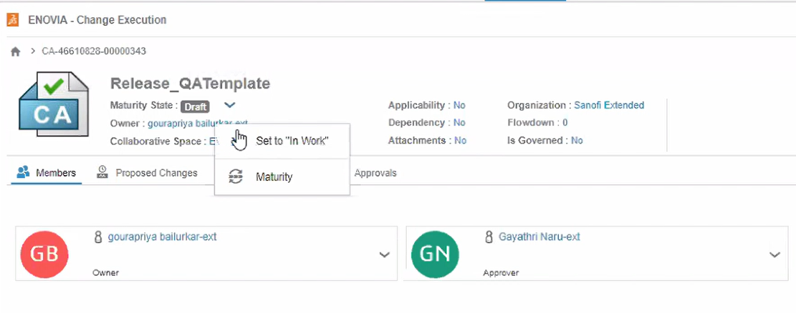
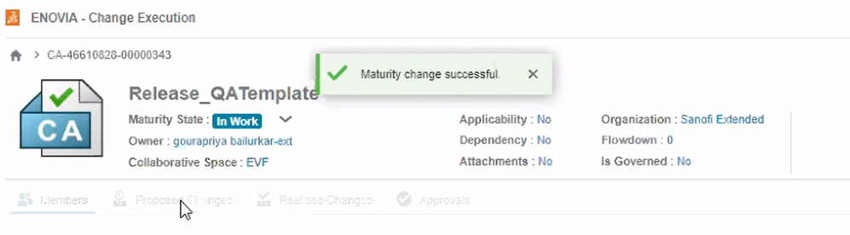
Change of Maturity state
16
16. The maturity state could be modified by clicking on the state.
17. The owner of the Change action will set the maturity from
DRAFT -> IN WORK -> APPROVAL.
18. After change of status a confirmation message will be displayed', And will be sent to the approver
17
18

Slide 24
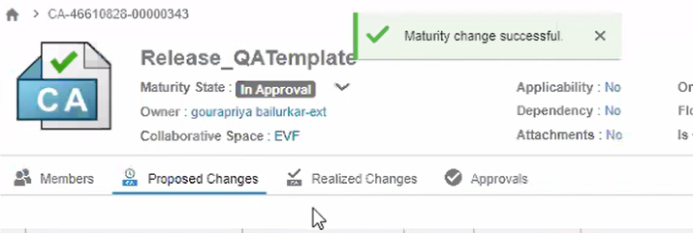
Change of Maturity state
19.The maturity of 'IN WORK' to 'IN APPROVAL' state has been changed by clicking on the small arrow next to the maturity state
After this step the Approver will get the notification alert regarding the assigned approval state and he will take over the process as explained in the next section.
19

Slide 25
05
Assigned Approver Releases the QA attribute

Slide 26
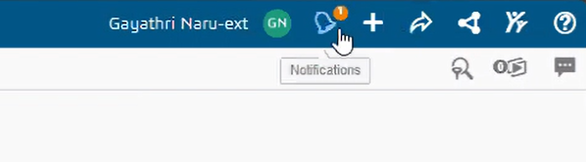
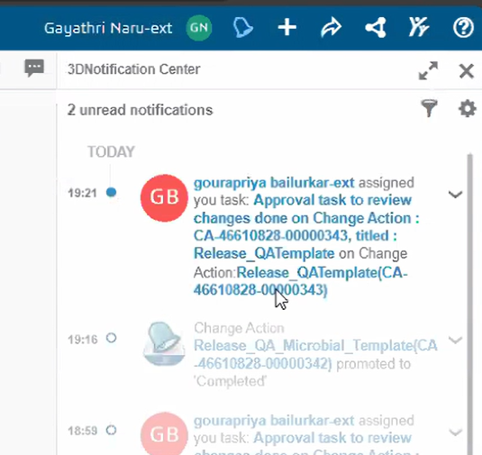
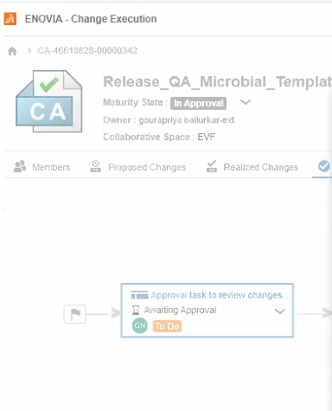
Notification & Approval of the Assigned Team member
1.The assigned approval will receive a notification.
2.By clicking on the notification information the tool will takes directly to the approval page.
3.By clicking on the arrow and selecting approval with the comments the attribute will be 'Released'.
1
2
3

Slide 27
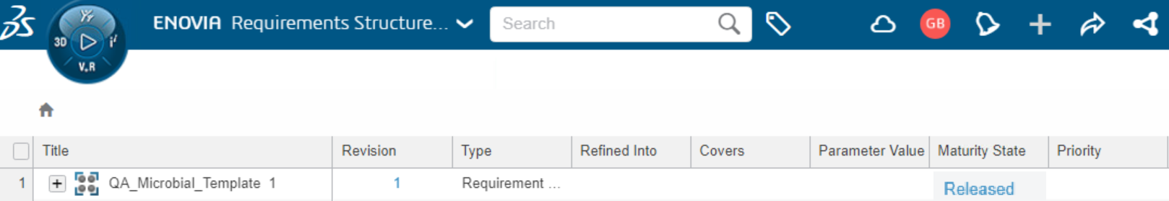
Released Template
4
1.When the created 'QA_Microbial_Template' is released the maturity status displays it .
2. Now the template is official, and it can be duplicated and adapted for future projects.

Slide 28
06
Creation of Product Specific Quality Attribute List

Slide 29
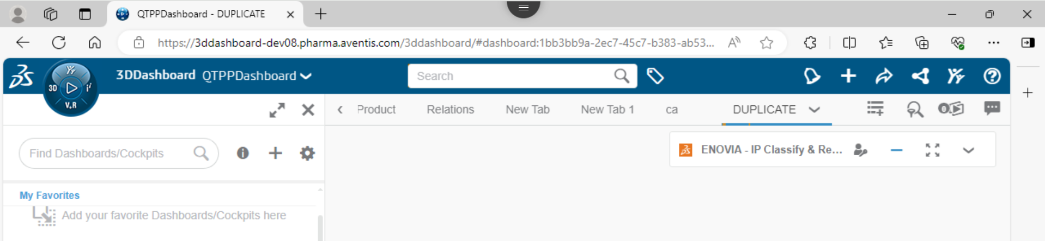

Creation of Product Specific Quality Attribute List
To create Product specific Quality Attribute List,
In Dashboard, Create a tab (DUPLICATE) and add IP Classify and Reuse app.
Go to the subclass under Product Family to open the Quality Attribute Template from which the Product specific Quality Attribute List will be created.(For Example let us take the QA Template from Slide 4 – QA_Microbial_Template)
1
2

Slide 30


Creation of Product Specific Quality Attribute List
3. Add Requirements app. In the same tab then Drag and Drop the QA Template from Step 2.(IP classify & reuse -> requirement structure editor).
4. Select the QA Template and open the Lifecycle tab in the bottom Menu and select 'Duplicate' icon.
3
Drag & Drop
4
4

Slide 31



Creation of Product Specific Quality Attribute List
5. On the Duplicate pop-up window, click on the Duplicate button.
6. The Product specific Quality Attribute List is created with same name as the QA Template. Double-click on the QA List to rename.(For Example: Antibody_Product_QA_List )
5
6
6

Slide 32




Creation of Product Specific Quality Attribute List
7. For the Product specific QA List, on Requirement Specification Editor under Quality Attributes add the Target Values.
8. Right-click the Quality Attribute, select “Information”. On the Information pop-up, click on “Edit” button to edit the Quality Attribute extension attributes - Criticality, Justification, Rationale and Impact on Safety/Efficacy .
7
8

Slide 33
07
Creating link between QTPP and Product Specific Quality Attribute List

Slide 34



Creating link between QTPP and Product specific Quality Attribute list
1
To create link between QTPP and Product specific Quality Attribute List,
In 3D Dashboard, Create a tab. Click on 3D Compass, Search for Requirements app and Drag and Drop the app in the New tab created in 3D Dashboard.
Search and open the Product specific QTPP.
2

Slide 35




Creating link between QTPP and Product specific Quality Attribute list
3. Search and open the Product specific Quality Attribute List.(For Example let us take the Product specific Quality Attribute List from Slide 29)
4. Select the QTPP attribute for which the Quality Attribute will be linked and right-click and select 'Start Link'.
3
4
4

Slide 36




Creating link between QTPP and Product specific Quality Attribute list
5. Now select the Quality Attribute which must be linked to the QTPP attribute and right-click and select 'End Link'.
6. On the 'Select a relationship' pop-up window, QTPP attribute and Quality Attribute is displayed. Select 'Downstream Requirement' option and click on "Confirm" button.
7. The link is created. For the QTPP Attribute in the Refined Into column displays 'Suspect' and Covers displays 'None'. For Quality Attribute, 'Refined Into' column displays "None" and Covers column displays 'Suspect.
5
5
6

Slide 37






Creating link between QTPP and Product specific Quality Attribute list
8. To make the link valid, Double-click on the "Suspect"' under 'Refined Into' column for the QTPP Attribute.
9. On the Link Management pop-up window, Quality Attribute select in Step is displayed in the box under 'List of objects refining Requirement <QTPP Attribute name>'. Click on the 'Suspect' button.
10. Select 'Valid' option in the dropdown. Once selected, 'Valid' is displayed in green box, making the link between QTPP Attribute and Quality Attribute valid. Now, click on 'Close' button on the 'Links Management' pop-up window.
8
9
10
10

Slide 38



Creating link between QTPP and Product specific Quality Attribute list
11
11. To view the relationship between the QTPP Attribute and Quality Attribute, select the QTPP Attribute, Right-click and select 'Information' option.
12. On the 'Information' pop-up, select the 'Relations' tab.
13. Expand the 'Refined into(1)', it displays the Quality Attribute used in the link.
14. Click on the arrow in box icon(highlighted in the image) to view Graph view.
12
9
14
10

Slide 39

Creating link between QTPP and Product specific Quality Attribute list
Graphical view of the link between QTPP Attribute and Quality Attribute

